Slide 1
MOTIF FINDER IN DNA SEQUENCES USING EXPECTATION MAXIMIZATION (EM) ALGORITHM
CS 412 SPRING 2020 PROJECT TEAM:
DEVIN V. TARK - devinvt2
GOWTHAM KUNTUMALLA - gowtham4
XIAOWEI LYU- lv7

Slide 2
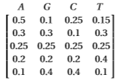
Introduction to Problem
A ‘motif’ is a pattern in a sequence, which is often in the form of ‘position weight matrix’ (PWM). The project involves developing a “motif finding” program and testing it. The three major components of the implementation are:
Building a benchmark
Implementing the “motif finder”
Evaluating the motif finder on the benchmark and making intelligent inferences.
We'll use Expectation-Maximization (EM) as our “motif finder”.
Example of PWM

Slide 3
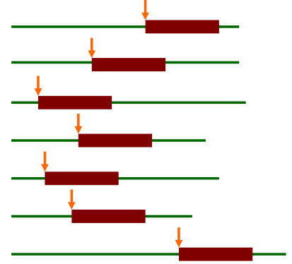
Description of EM Algorithm
The Expectation-Maximization (EM) is a family of algorithms for learning probabilistic models in problems that involve latent variables. The algorithm has four parts:
Initialization
Expectation Step
Maximization Step
Exit condition
Bailey and Elkan uses EM algorithm for discovering motifs in a group of DNA sequences.
Latent variables in motif finding: where the motif starts in each training sequence (sites)

Slide 4
EM Algorithm (at a high level) Pseudocode
EM (dataset, W) {
Initialization: Find the most common subsequences as starting points;
Generate an initial PWM;
While (iterations < n_iter): {
Estimate motif positions Z_ij from motif matrix (E-Step);
Update the PWM from all positions Z_ij (M-Step);
}
}

Slide 5
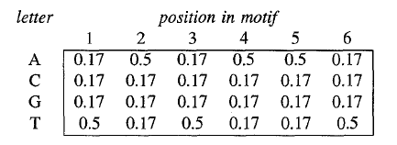
Initializing the Start Point (B&E 1995)
Sequences of length L = motif length are relatively unique
Can create a very small search space of likely Motif Candidates by taking the top ~20 most common subsequences
Initialize the array as below.
Perform expectation step
Choose PWM with maximum likelihood

Slide 6
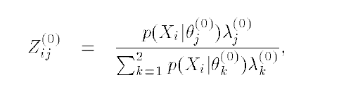
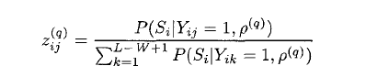
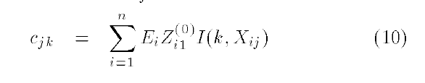
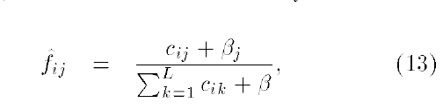
Z Table Updating -> PWM updating
1.
vs.
(1995)
(1994)
Bayesian Counter. Likelihood of a letter being in the motif position indicated by how strong we believe a motif is represented in that position
2.
3.

Slide 7
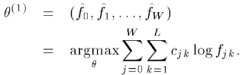
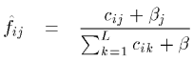
Experiments
We modified the number of iterations n_iter and hyper parameter beta which is used in the calculation of letter frequency in the maximization step. Experiments (-computer simulations) were run using
n_iter∈{10, 100, 500, 1000}
beta∈{0.001, 0.01, 0.02, 0.025, 0.05, 0.1}
Default values that are used in running experiments are n_iter=100 and beta=0.01
Beta is a parameter used in re-estimating θ.

Slide 8
Parameters sets
ICPC, ML, SL, SC
0. [1.0, 7, 500, 10] :Datasets [0, 1, 2, 3, 4, 5, 6, 7, 8, 9]
1. [1.5, 7, 500, 10] :Datasets [10, 11, 12, 13, 14, 15, 16, 17, 18, 19]
2. [2.0, 7, 500, 10] :Datasets [20, 21, 22, 23, 24, 25, 26, 27, 28, 29]
3. [1.5, 6, 500, 10] :Datasets [30, 31, 32, 33, 34, 35, 36, 37, 38, 39]
4. [1.5, 8, 500, 10] :Datasets [40, 41, 42, 43, 44, 45, 46, 47, 48, 49]
5. [1.5, 7, 500, 5] :Datasets [50, 51, 52, 53, 54, 55, 56, 57, 58, 59]
6. [1.5, 7, 500, 20] :Datasets [60, 61, 62, 63, 64, 65, 66, 67, 68, 69]

Slide 9
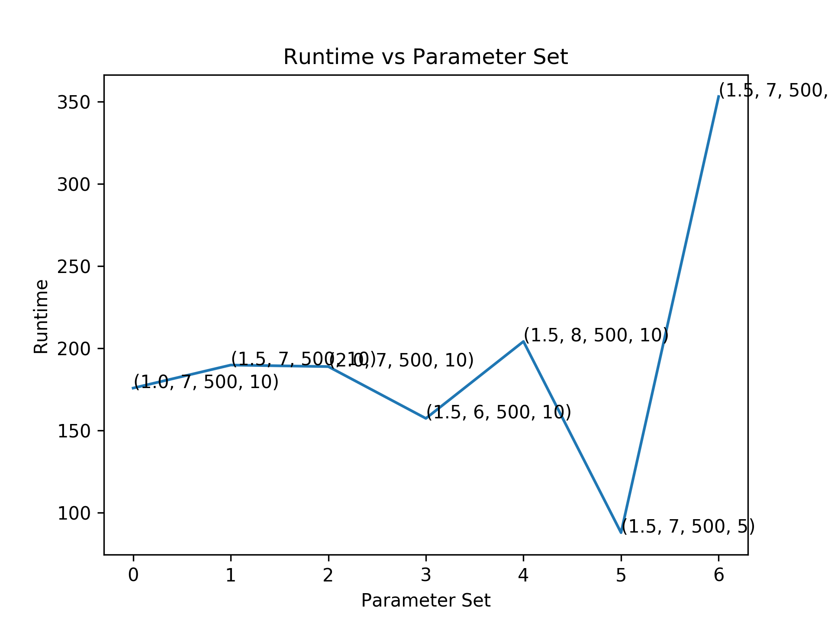
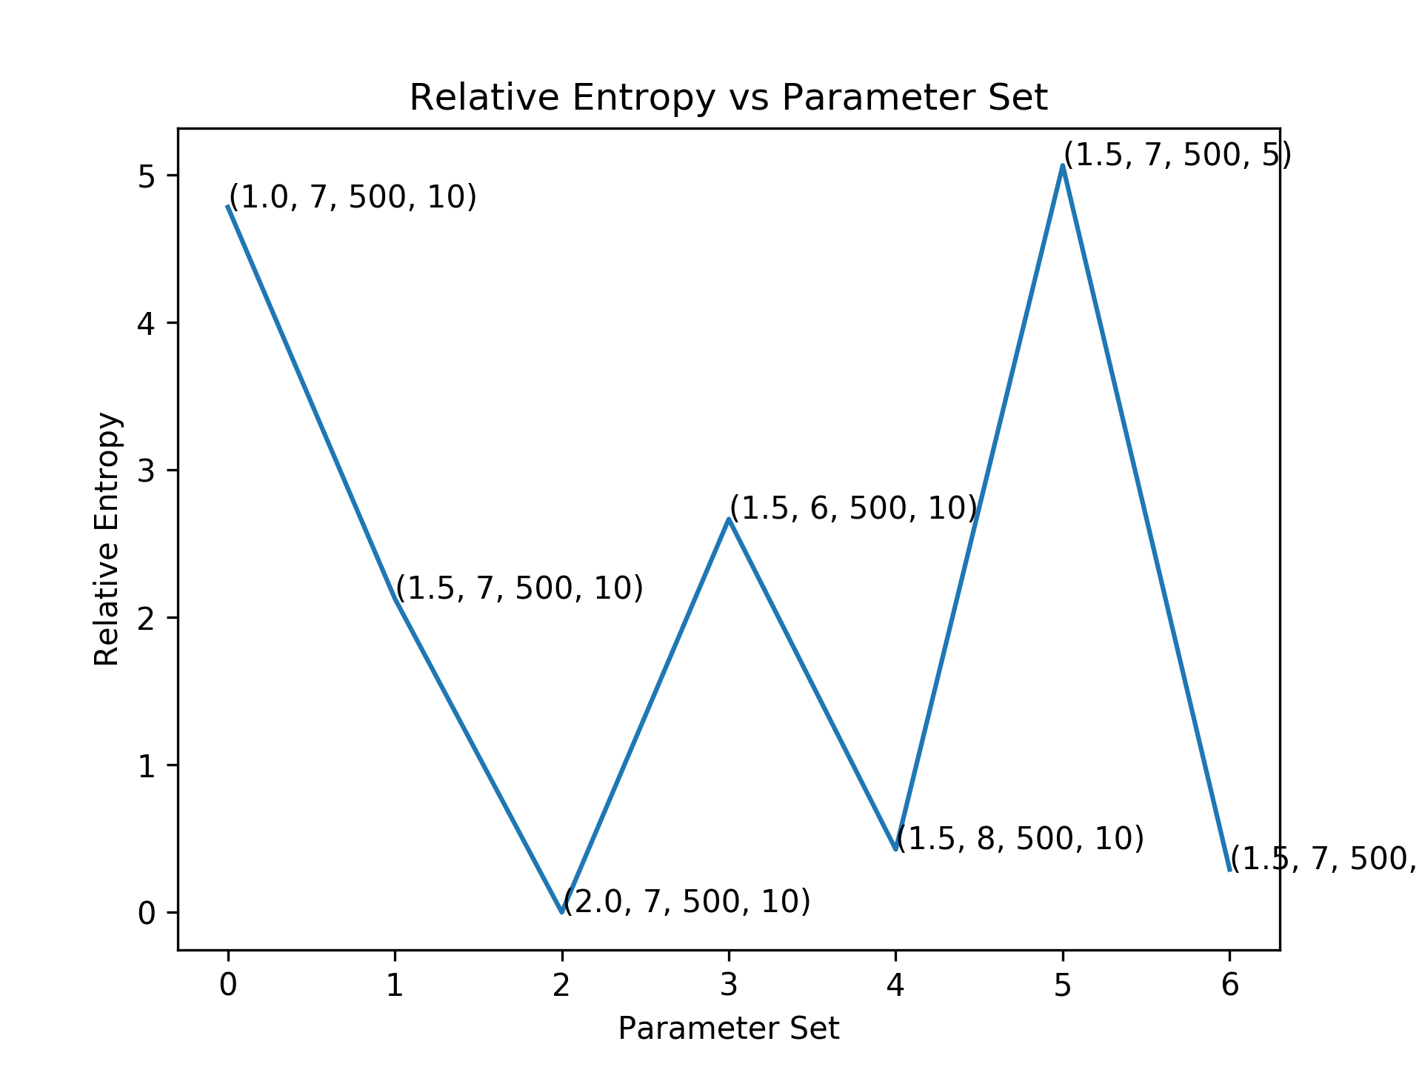
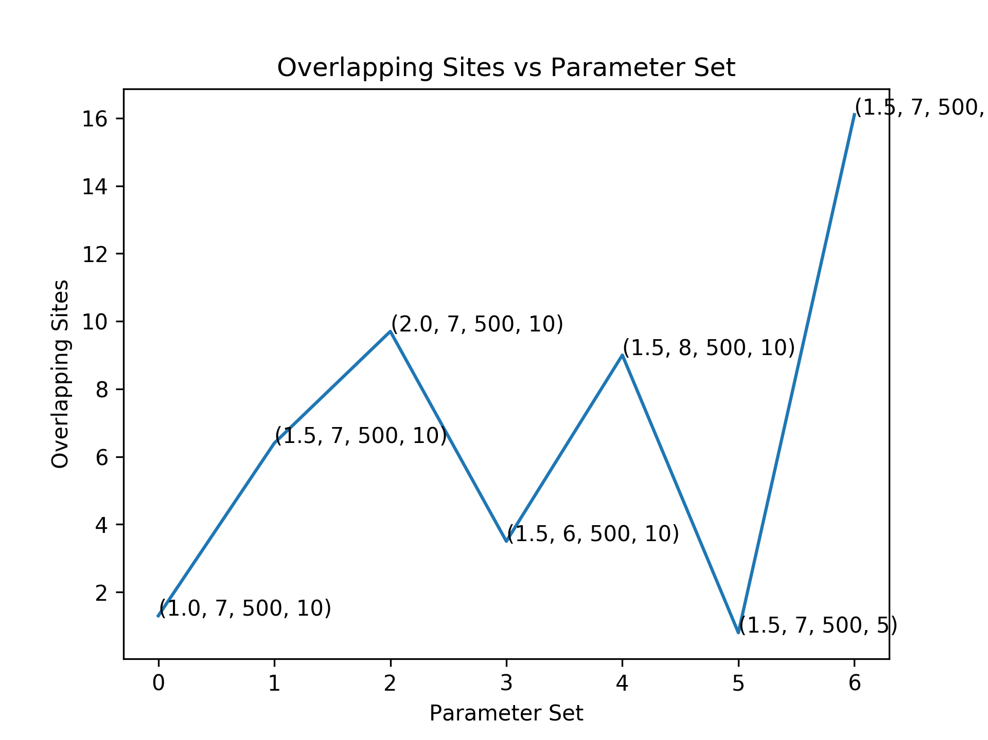
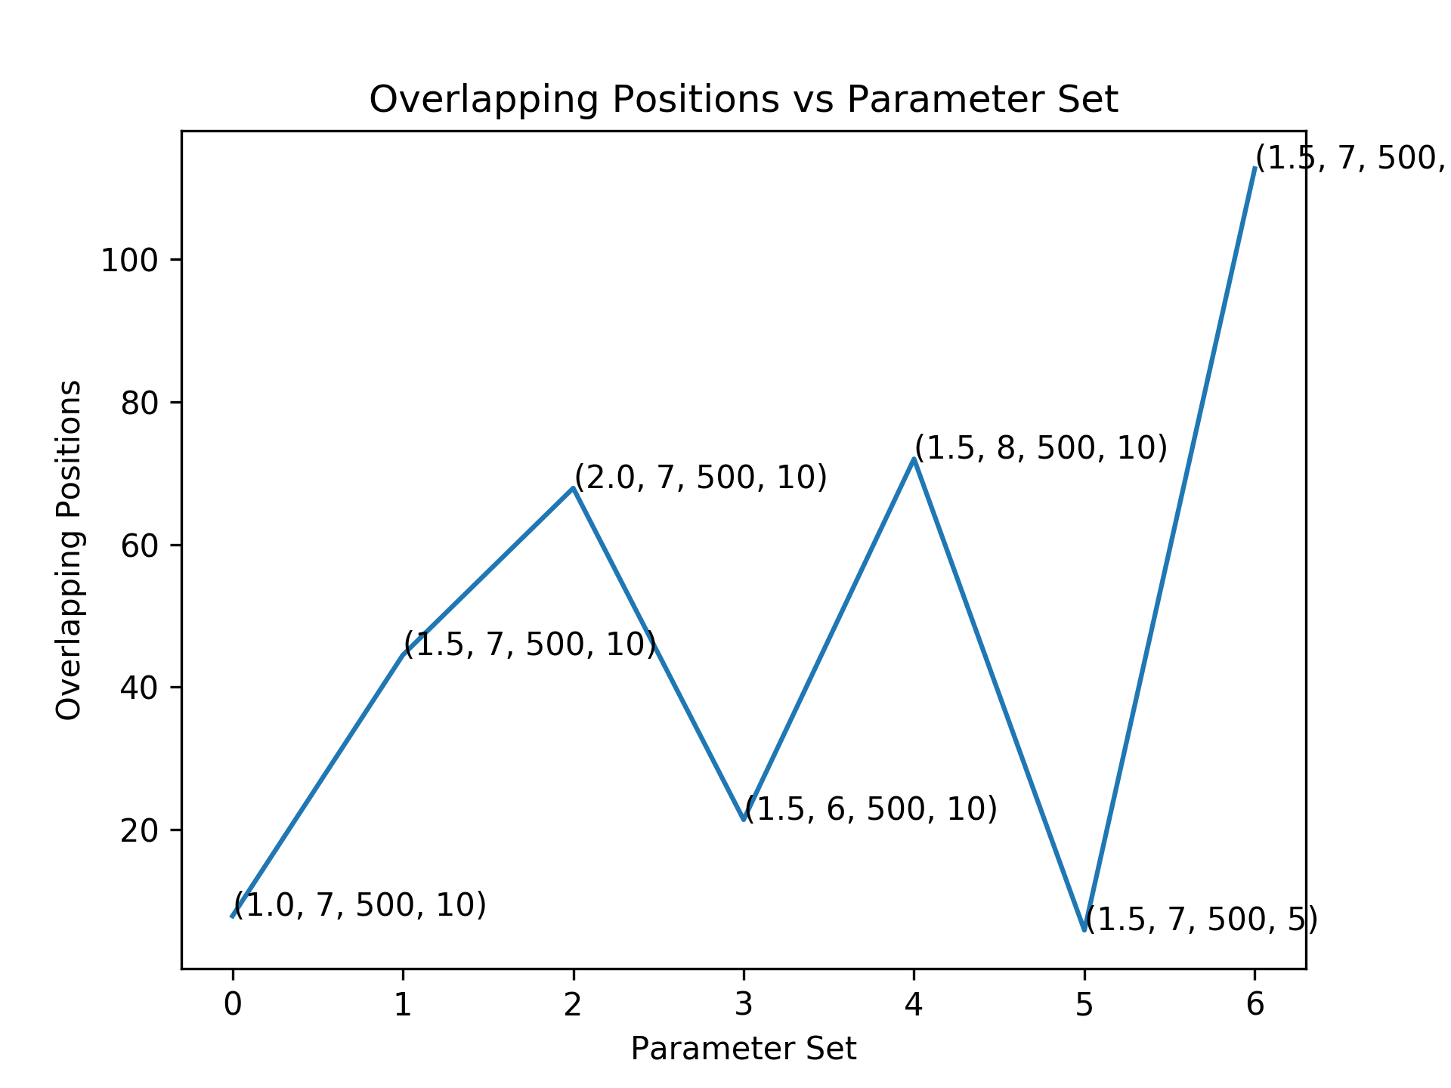
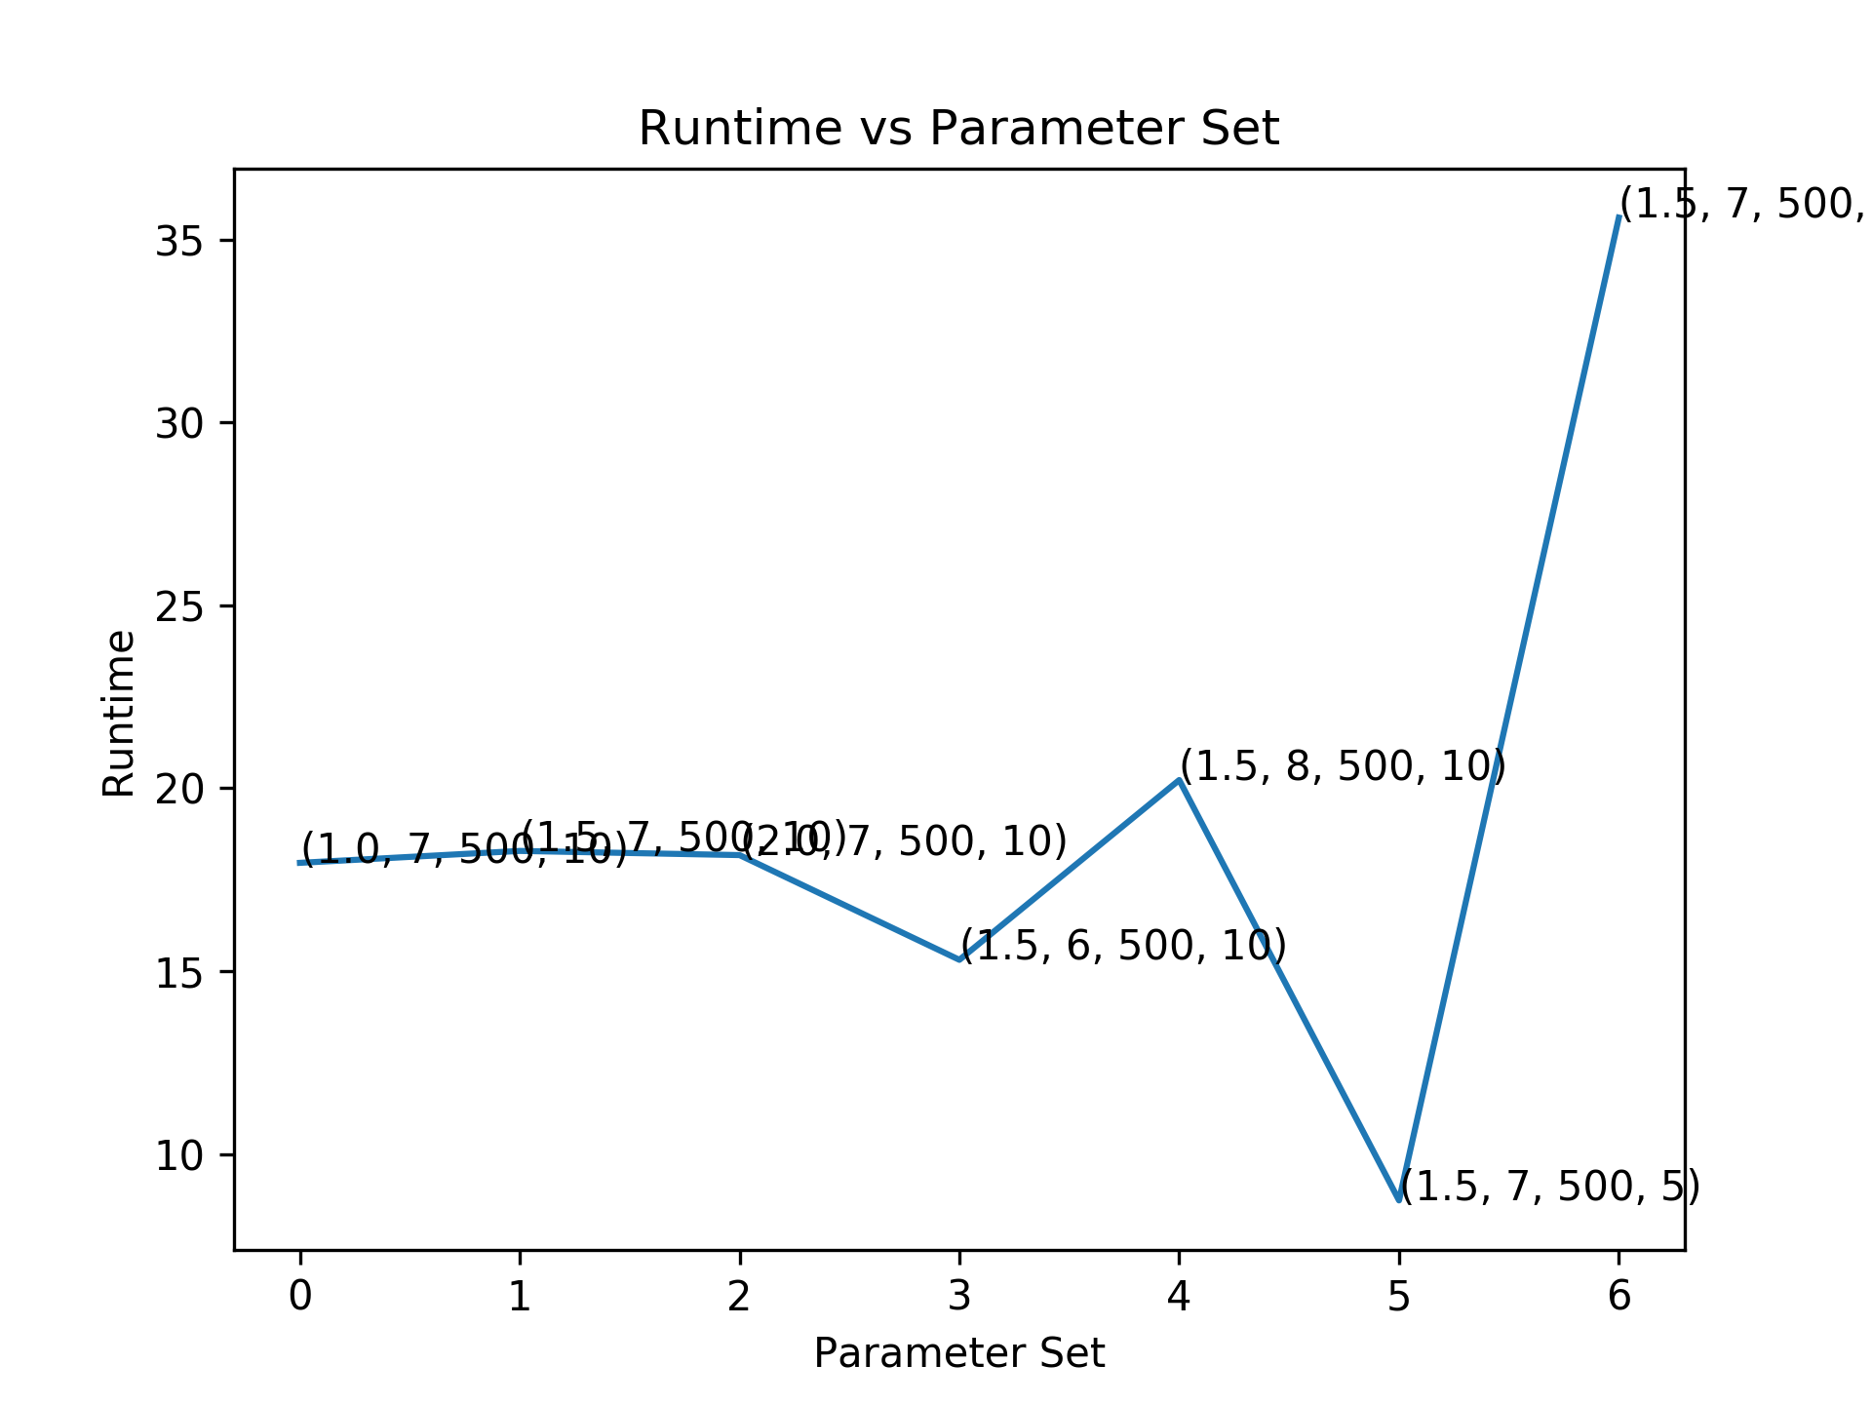

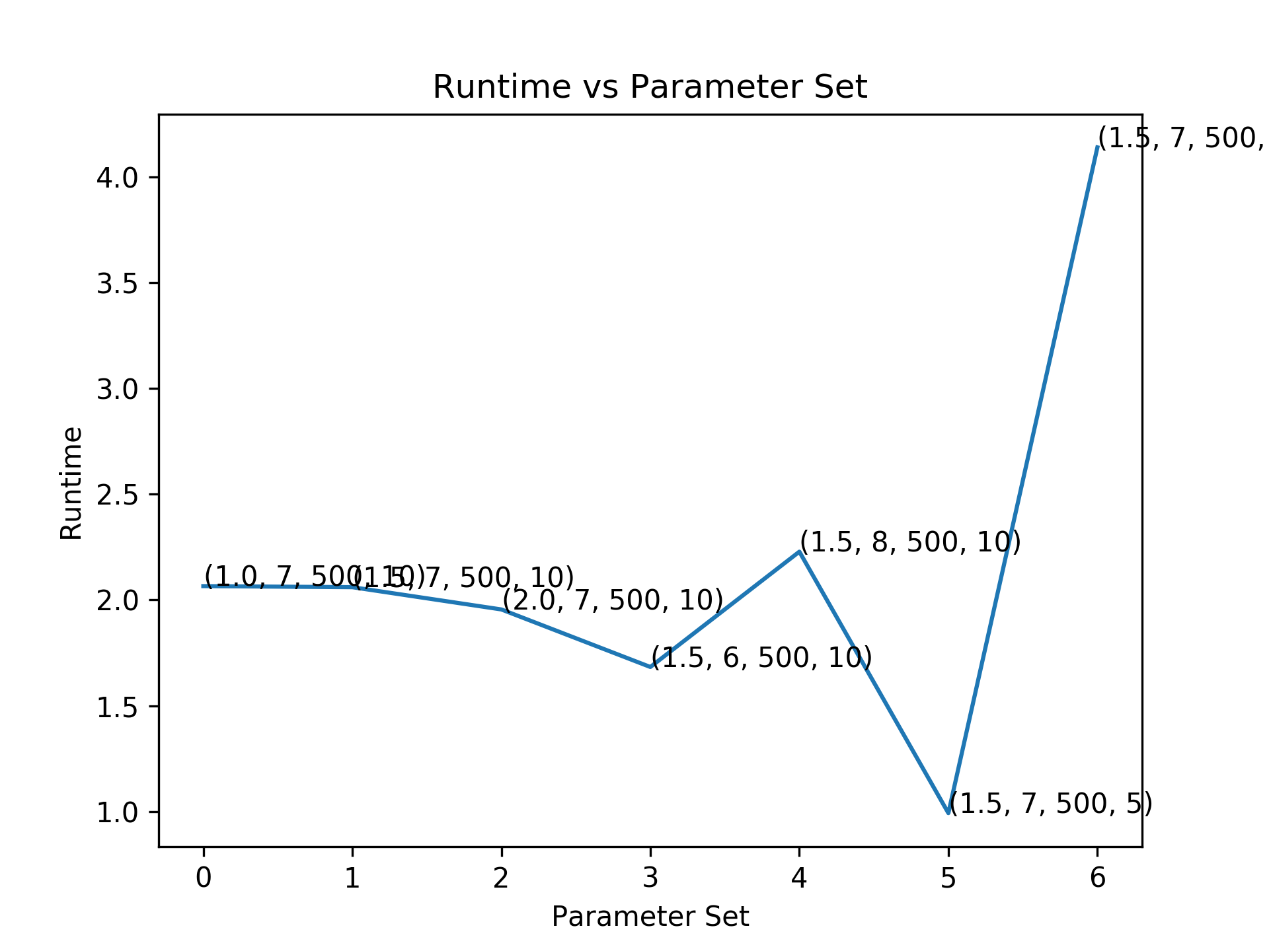
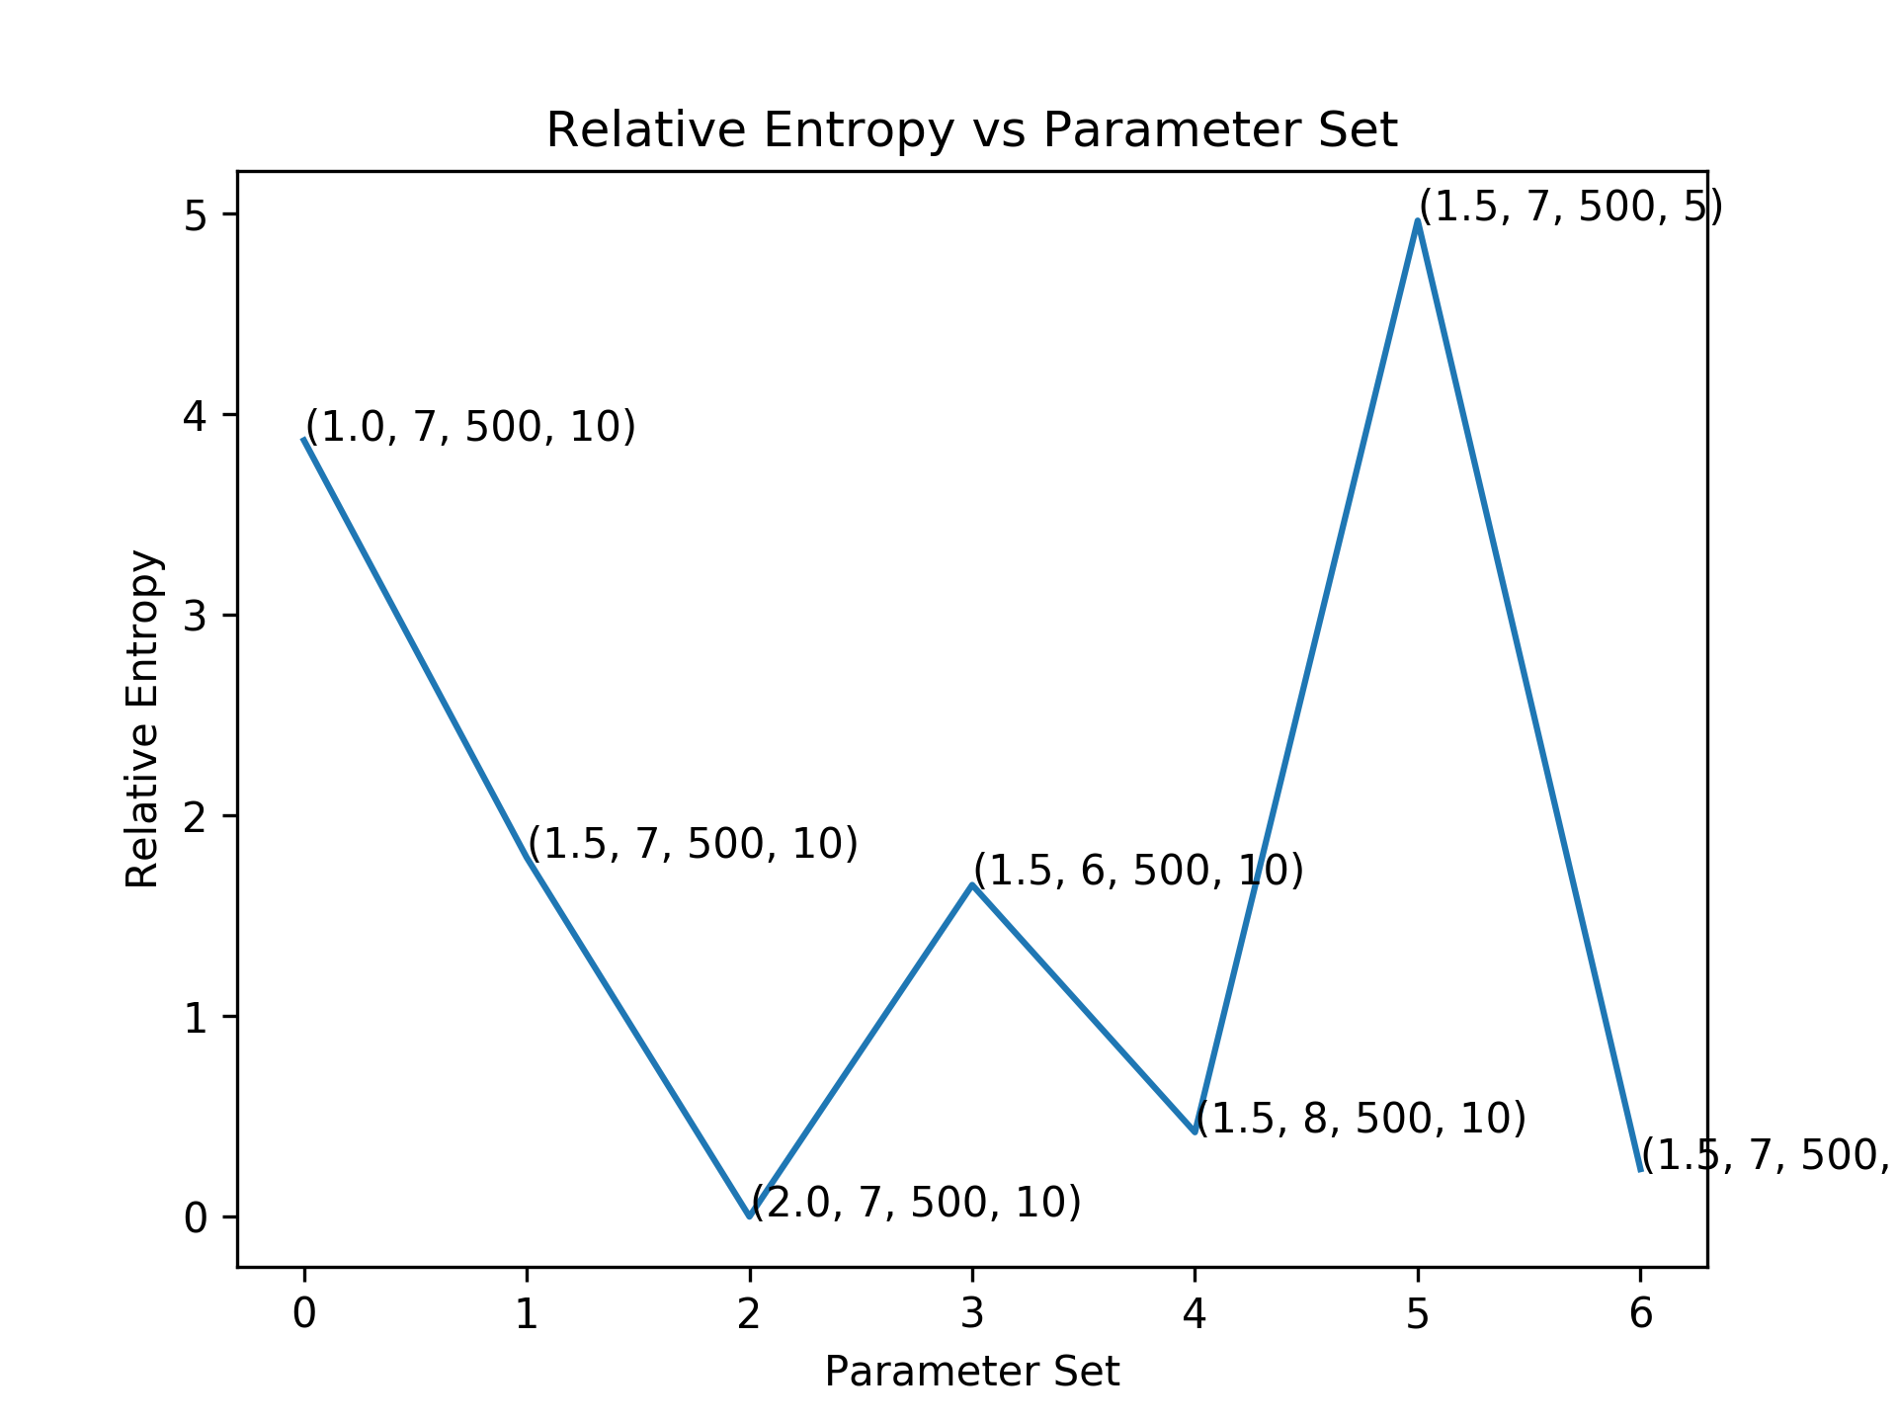
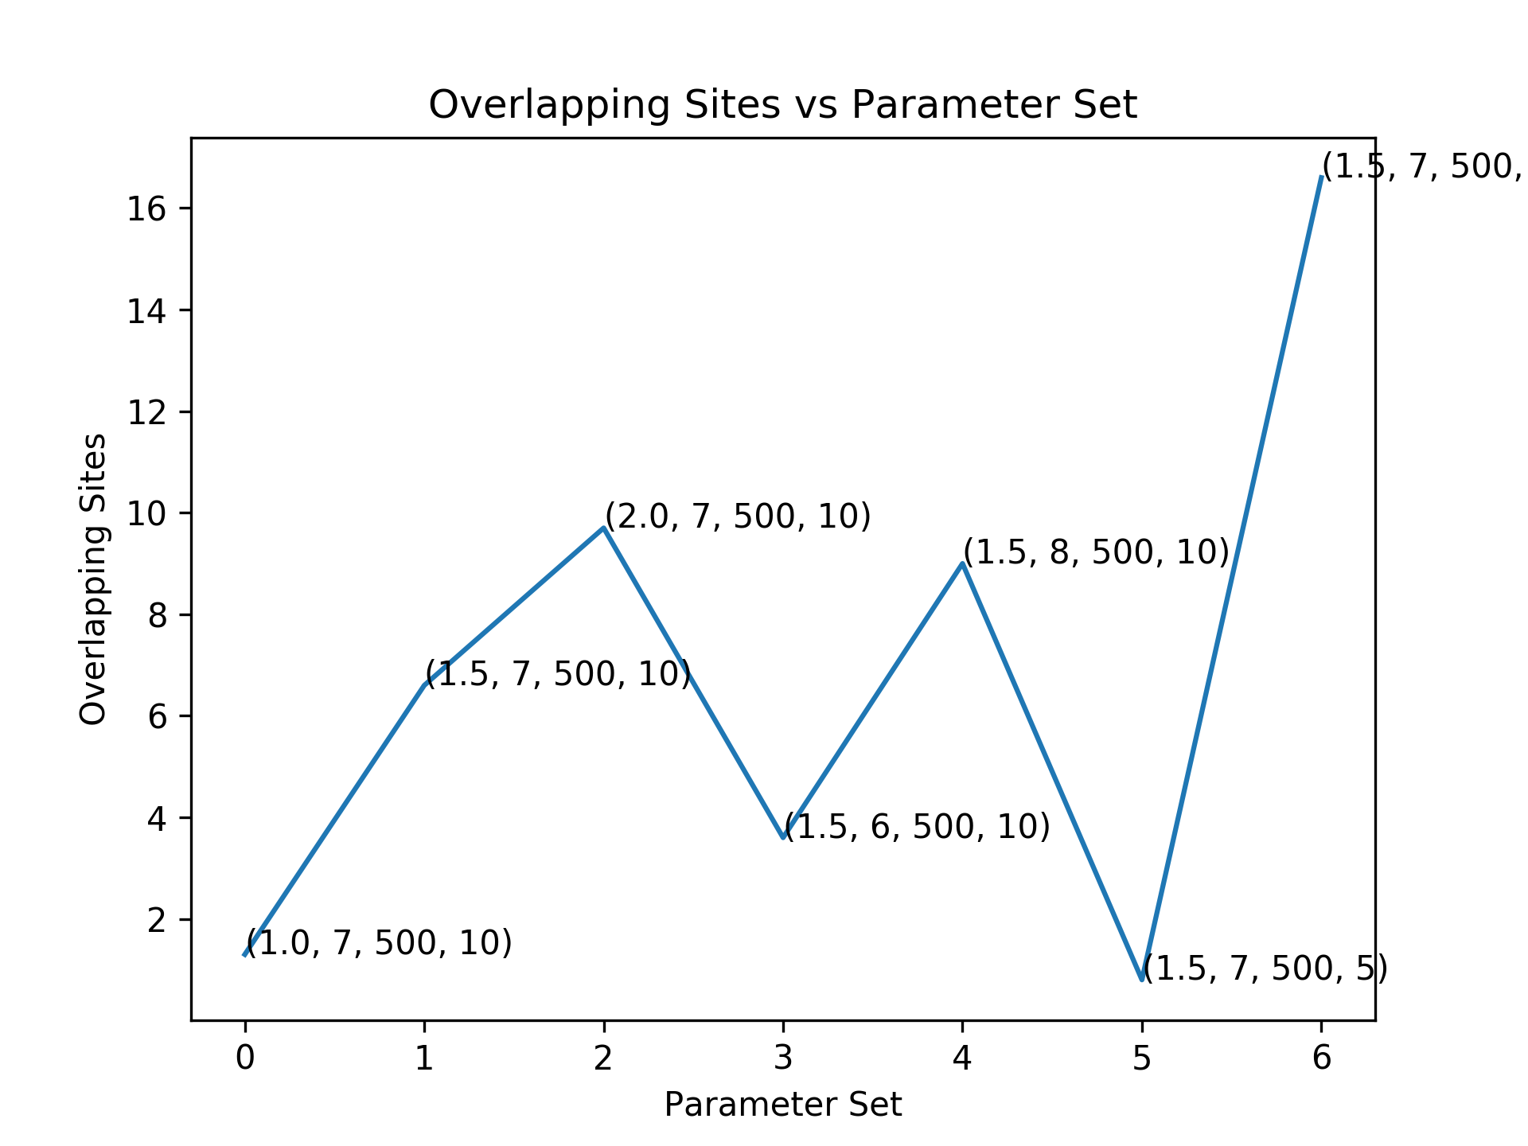
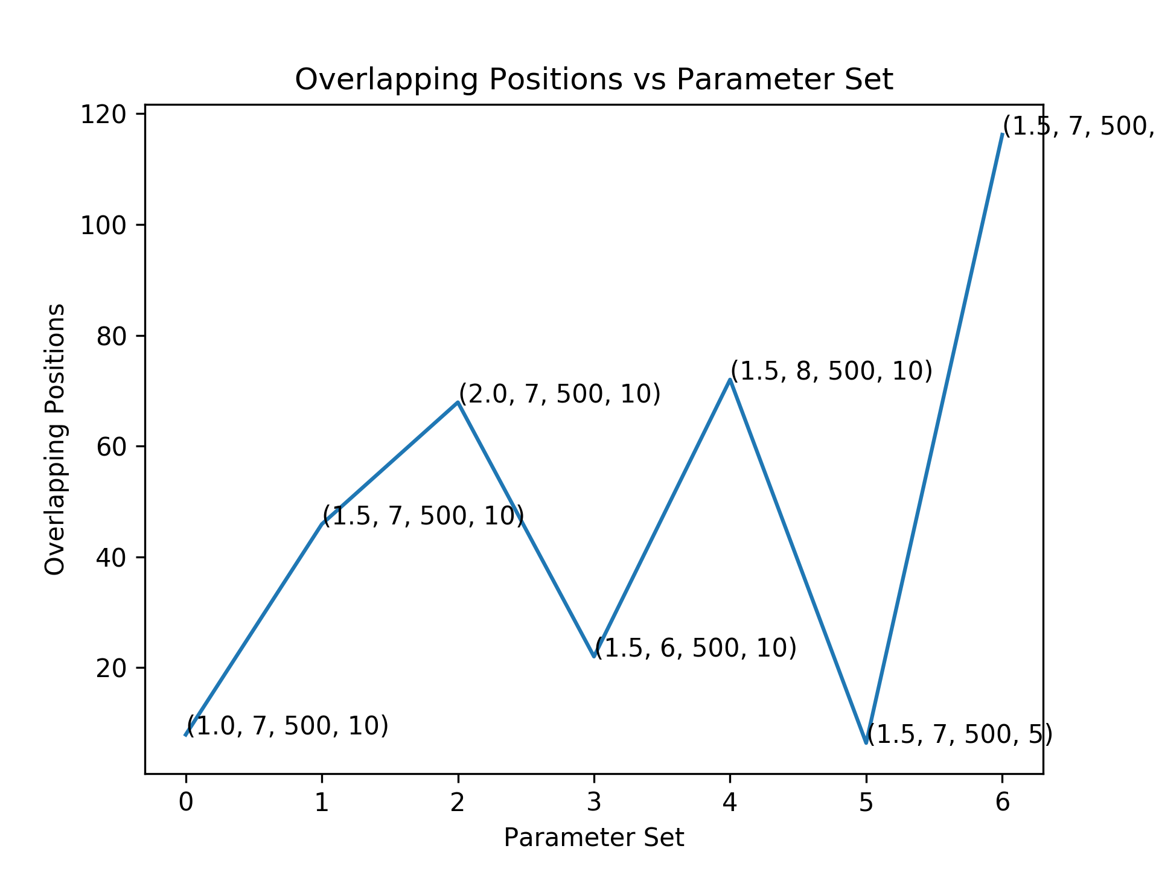
Point annotations: (Information content per column (ICPC), Motif length, Sequence length, Number of sequences)
N_iter=1000
Beta=0.01
N_iter=100
Beta=0.01
N_iter=10
Beta=0.01

Slide 10
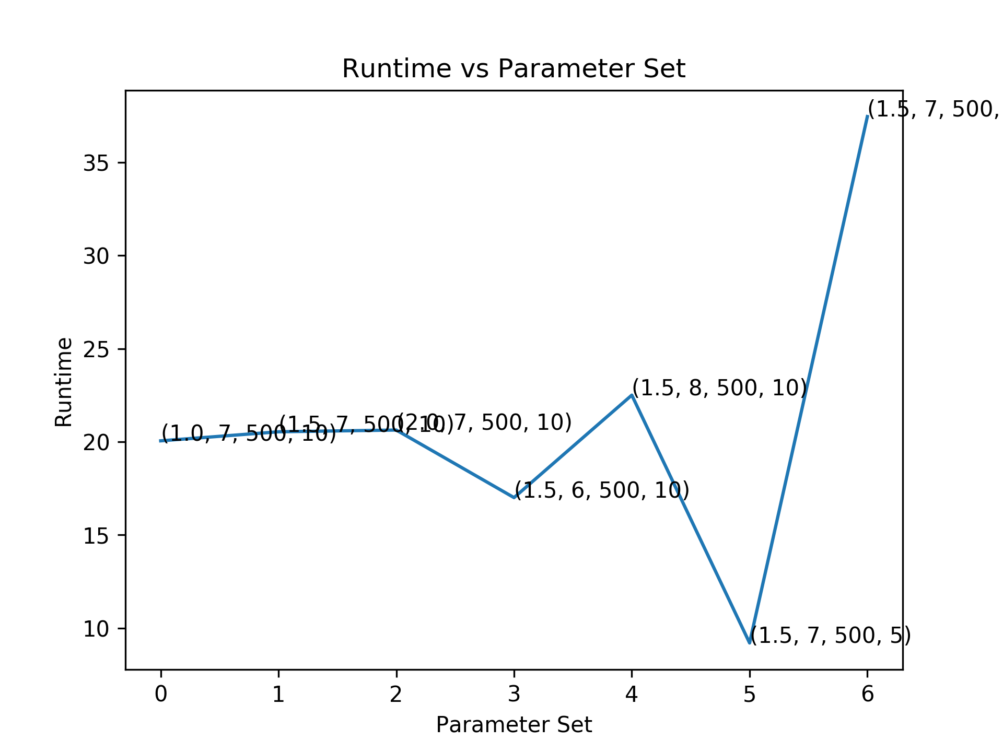

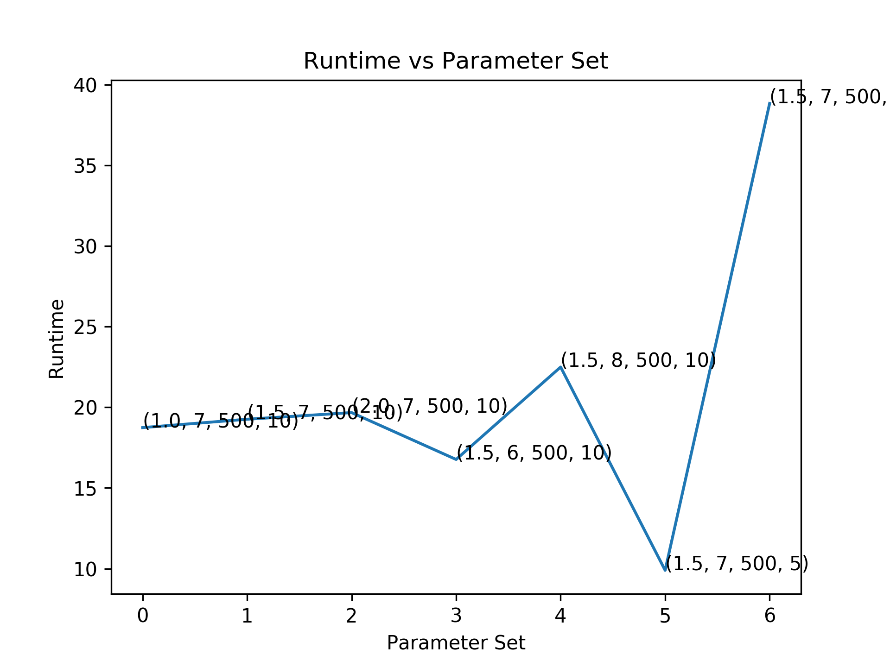




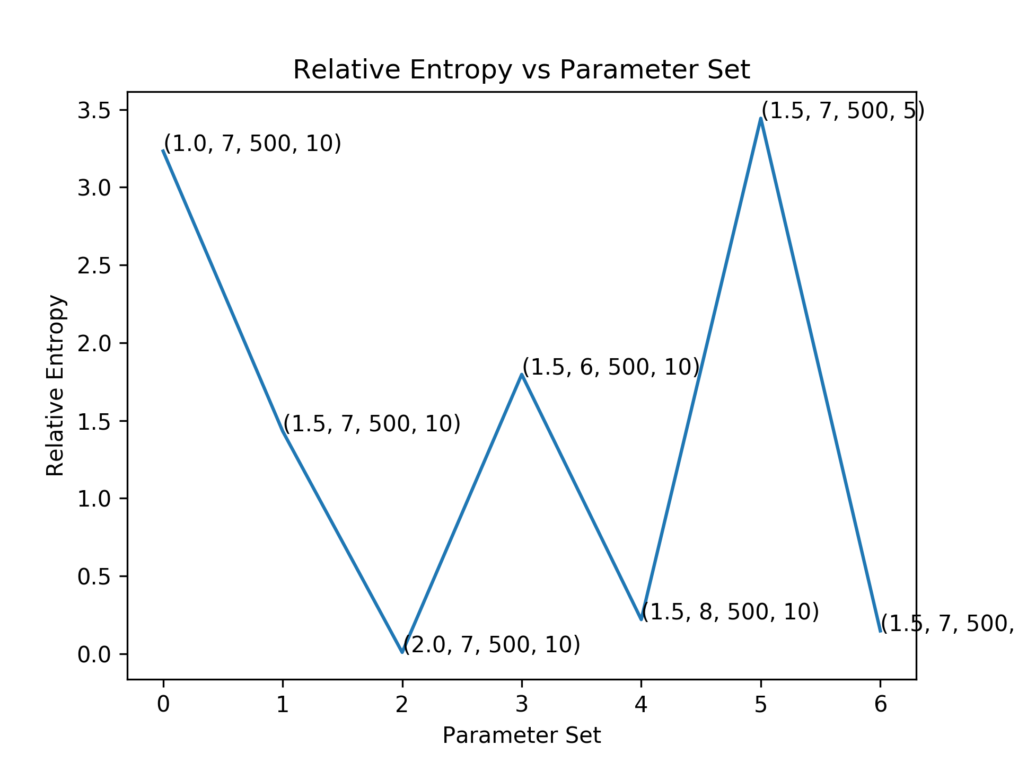

N_iter=100
Beta=0.001
N_iter=100
Beta=0.025
N_iter=100
Beta=0.1

Slide 11
Conclusion
We find that
Initialization is an important step and takes a significant role in finding an optimal solution
Higher information content (ICPC) is associated with better predictions. For instance, this algorithm perfectly predicts the motif sites for ICPC = 2.
Algorithm usually converges for n_iter>100. In case of higher ICPC the convergence is even quicker.
Changing hyper parameter beta doesn’t have a strong trend, but higher values seem to have lower relative_entropy. beta=0.1 has the lowest relative_entropy amongst the tested values.

Slide 12

Thank You
CS412 Instructors
Prof. Saurabh Sinha
TAs

